Slide 1
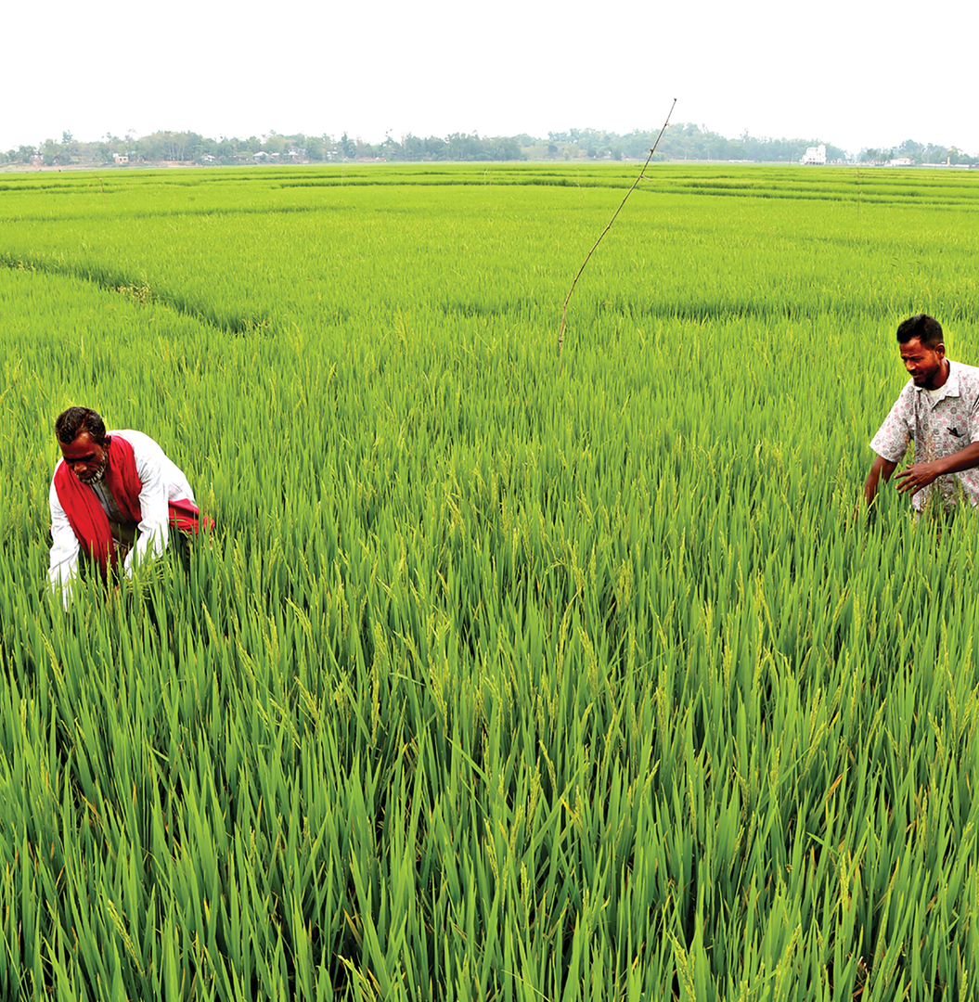
POLICY BRIEFING / 2026
Fertilizer Management in Bangladesh
Crisis, Resources, Regional Lessons, and the Path to Accountability
Stocks pile up in warehouses. Farmers queue for hours and pay double. A subsidy meant for the poor enriches the wealthy. This briefing examines what is broken, what Bangladesh already has, and what its neighbours can teach it.
•
•
PREPARED FOR EXECUTIVE & MEDIA BRIEFING
18
SLIDES
SOURCE: GOVT DATA, WORLD BANK, FIELD REPORTS
BANGLADESH · RICE BELT
Notes:
- Open by framing the contradiction — warehouses are full, yet farmers can't buy fertilizer at official prices.
- Position this as a media/exec briefing covering crisis data, fiscal burden, regional lessons, and reform roadmap.
- Set expectation: 18 slides across four sections — crisis, resources, regional lessons, accountability.
- The hero image of a Bangladeshi rice paddy locates the human stakes behind the numbers.

Slide 2
EXECUTIVE OVERVIEW
Stocks on paper. Shortages in the field.
Bangladesh holds over 1.36 million tonnes of fertilizer in warehouses and has approved 365,000 tonnes of fresh imports at Tk 2,562 crore. Yet farmers across the country are paying up to double the official price — and the subsidy that should reach them flows largely to the wealthiest landowners.
STOCKS VS FIELD
SUBSIDY CAPTURE
PRICE GAP
1.36M t
80%
2×
Tonnes of fertilizer in warehouses — yet farmers in 8+ districts report being unable to buy at official prices.
Of public agriculture spending goes to fertilizer subsidies — but the top 20% of landowners capture roughly half.
Farmers in Jashore pay Tk 52/kg for TSP — nearly double the government-fixed rate of Tk 1,350 per 50kg sack.
This briefing unpacks the crisis, the resources already in place, and the regional lessons that point to a path forward.
Notes:
- One-line setup: three numbers capture the entire problem — abundance on paper, scarcity in the field, subsidy that misses its mark.
- The deck progresses through crisis → subsidy → resources → regional → reform.
- Frame 1.36M tonnes as paper abundance versus real-world scarcity.
- Highlight that 80% subsidy capture flows disproportionately to the top 20% of landowners.
- Use the Jashore 2× price gap as the human-cost anchor for the rest of the deck.

Slide 3
FERTILIZER MANAGEMENT · BRIEFING
01
CHAPTER ONE
The Present Crisis
Stocks on paper, shortages in the field — a system failing at the point of delivery.
FERTILIZER MANAGEMENT IN BANGLADESH / 03
Notes:
- Transition cue — now to the present crisis.
- Three slides ahead: the paradox in numbers, regional price gaps, and official admissions of distribution failure.
- Set the stakes — this section is the empirical foundation for the reform argument that follows.
- Pause briefly on the ghost "01" to let the section open breathe before the data hits.

Slide 4
THE PARADOX
Warehouses are full. Farmers cannot buy.
Official data shows healthy national stocks and large fresh imports. But lift-off data — what dealers actually pull from warehouses — tells the opposite story in division after division.
WHAT THE GOVERNMENT HAS
WHAT DEALERS ACTUALLY LIFTED
1.365M
Gazipur
43%
tonnes of fertilizer in warehouses
365,000
Only 800t of 1,876t allocated urea distributed by Aug 20
Dhaka Division (8 districts)
tonnes of fresh imports approved
45%
Tk 2,562 cr
8,965t lifted against 19,918t allocated
cost of those imports
Mymensingh Division
32%
9,992t lifted against 31,425t allocated
Source: Ministry of Agriculture, August 2025 lift-off data.
Notes:
- Cue the central paradox — nationally the cupboards are full, but at the district level, dealers are lifting less than half of what's allocated.
- 1.365M tonnes in warehouses plus 365,000t of fresh imports at Tk 2,562 cr should signal abundance.
- Reality on the ground: Gazipur 43%, Dhaka Division 45%, Mymensingh 32% — distribution is the broken link.
- This is the smoking gun for distribution failure, not supply shortage.

Slide 5
FROM THE FIELD
Farmers pay nearly double — and some take fertilizer by force.
Across four districts, the gap between the official price and the black-market price ranges from 30% to 65%. In Kurigram, frustration boiled over into a warehouse break-in.
Rajshahi
Jashore
RAJSHAHI DIVISION
KHULNA DIVISION
Tk 1,700–1,800/bag
Tk 52/kg
vs official Tk 1,350/bag (TSP)
vs official Tk 1,350/bag (TSP)
Premium of Tk 350–450 per 50kg sack over the government-fixed rate.
Nearly double the official rate — fertilizer sold by the kilogram, not the bag.
Kurigram
Lalmonirhat
RANGPUR DIVISION
RANGPUR DIVISION
10,000 kg urea
Up to Tk 2,200/bag
Seized by force — warehouse breached
vs official Tk 1,350/bag
Frustrated farmers broke open a warehouse and took fertilizer by force.
Farmers blocked a highway in protest — nearly double the official price.
Source: Field reports, August–September 2025.
Notes:
- Emphasise this isn't a one-off in one district — it is a nationwide pattern.
- Rajshahi and Lalmonirhat show the 30–65% price premium farmers actually pay.
- Jashore is the striking case: per-kilogram sales signal informal breaking of bags at the dealer level.
- The Kurigram warehouse break-in is the canary in the coalmine — frustration is boiling over into direct action.
- Set up the next slide: this is what the government's own officials now admit.

Slide 6
OFFICIAL WORD
The government says there is no crisis. Its own officials disagree.
“
In some cases, their negligence and collusion with dealers are creating the crisis.
— ADDITIONAL SECRETARY, FERTILIZER MANAGEMENT, GOVERNMENT OF BANGLADESH
Agriculture Secretary warned of strict action against those creating “artificial crises.”
Officials acknowledged “negligence and alleged collusion among some dealers and field-level officials.”
Some dealers fail to lift allocated stocks, creating artificial shortages — subsidized fertilizer is diverted to the black market.
ACCOUNTABILITY PIVOT · BRIEFING 06
Notes:
- This is the deck's accountability pivot — the government's own officials are admitting the problem is internal.
- Frame the Additional Secretary's quote as the moment the official narrative cracks.
- Three corroborating points: Secretary's warning, official acknowledgement of collusion, and the diversion mechanism.
- Use this as the bridge into reform options — the diagnosis is now on the record.

Slide 7
02
CHAPTER TWO
The Subsidy
Burden
A fiscal tightrope — immense spending,
regressive outcomes.
CHAPTER TWO OF FOUR
FERTILIZER MANAGEMENT IN BANGLADESH / 07
Notes:
- Transition cue: the crisis is not just a distribution problem — it is a fiscal one.
- The subsidy is enormous, and it reaches the wrong people.
- This chapter sets up the math, then the equity failure.
- Pace the section slowly — these are the deck's most damning numbers.

Slide 8
FISCAL SCALE
A subsidy so large it crowds out everything else.
Bangladesh's fertilizer subsidy consumes the bulk of agricultural spending — and remains vulnerable to global shocks, with Tk 1,350 crore in additional subsidy required in 2025-26 due to the Middle East conflict.
PER-KILOGRAM SUBSIDY
BUDGET ALLOCATIONS
Tk 89/kg
Tk 17,001 cr
Tk 1,350 cr
80%
Subsidy on DAP (Diammonium Phosphate)
Of public agriculture spending channeled into fertilizer subsidies (World Bank estimate)
FY2026-27 agricultural subsidies budget (incl. fertilizer support)
Additional fertilizer subsidy required in 2025-26 (Middle East conflict impact)
Tk 35/kg
Subsidy on urea
Sources: Bangladesh national budget FY2026-27; World Bank agricultural public spending review.
Notes:
- Land the scale — Tk 17,001 crore is roughly equivalent to the entire higher education budget.
- Per-kg subsidy on DAP (Tk 89) is more than double the urea subsidy (Tk 35) — explains product mix distortion.
- Tk 1,350 crore additional subsidy in 2025-26 is a direct fiscal exposure to the Middle East conflict.
- 80% figure is the World Bank's framing — bridge to next slide: this money doesn't reach the right people.

Slide 9
WHO BENEFITS?
The wealthy capture the subsidy. The poor pay black-market prices.
The World Bank's assessment is unambiguous: Bangladesh's fertilizer subsidy is not just inefficient — it is regressive, distorting fertilizer use and crowding out investment in research, irrigation, and climate resilience.
SHARE OF FERTILIZER SUBSIDIES BY LANDOWNER WEALTH QUINTILE
Top 20% landowners
~50%
Bottom 40% landowners
~15%
Rest (middle 40%)
~35%
“Only around 5 percent of farmers apply a balanced mix of nutrients within recommended levels.”
— WORLD BANK ASSESSMENT
Source: World Bank public spending review, Bangladesh agriculture.
Notes:
- The deck's moral pivot — a subsidy that captures 80% of agriculture spending reaches the wealthiest 20% half the time.
- Top 20% landowners capture ~50% of subsidies; bottom 40% capture only ~15%.
- This is what 'regressive' looks like in numbers — pair this slide with slide 08's fiscal scale.
- Only ~5% of farmers use balanced nutrient mixes — distortion is technical as well as fiscal.
- Bridge to Chapter Three: Bangladesh already has the data tools to fix this.

Slide 10
CHAPTER THREE
03
Resources
Bangladesh
Already Has
Four assets already in motion —
the building blocks of reform.
CHAPTER THREE OF FOUR
FERTILIZER MANAGEMENT IN BANGLADESH / 10
Notes:
- Transition cue: despite the crisis, Bangladesh already has the pieces in place.
- Four assets stand out: digital land mapping, the Krishak Card, a new dealer policy, and domestic production capacity.
- This chapter reframes the deck from problem to possibility.
- Stress that these are existing assets — not aspirational.

Slide 11
IDENTITY + GEOSPATIAL
Digital land mapping and farmer identity — the data foundations.
Two flagship initiatives already underway give Bangladesh the data backbone it needs to target fertilizer subsidies accurately — verified land parcels and a verified farmer identity layer.
PILLAR 01
PILLAR 02
Digital Land Mapping
The Krishak (Farmer) Card
Bangladesh Digital Survey (BDS) + Establishment of Digital Land Management System (EDLMS)
Launched April 2026
A digital identity layer storing around 120 types of farmer information. Initially 20,671 landless, marginal, and small farmers in 10 upazilas receive Tk 2,500 annually via mobile financial services — with plans to make the cards usable as debit cards. This is the authentication key for fertilizer purchases.
Modernising land records with digital mapping. Over 20,000 mouza maps already integrated, with 138,000 more under digitization. By 2026, BDS aims for a fully digital, secure, citizen-friendly land management system. A Memorandum of Understanding with South Korea, signed in September 2025, is accelerating the work.
20,000+
138,000
2026
120
20,671
10
Mouza maps integrated
Under digitization
Target go-live
Data fields per farmer
Farmers in pilot
Upazilas covered
Notes:
- Two pillars of identity (Krishak Card) and land (BDS / EDLMS) — together they make targeted, land-linked fertilizer quotas technically possible.
- Krishak Card launched April 2026; pilot covers 20,671 farmers across 10 upazilas with Tk 2,500 annual transfer.
- BDS already has 20,000+ mouza maps integrated; 138,000 more under digitization; South Korea MoU accelerating work.
- Bridge: with these data layers in place, targeting becomes a policy choice, not a technical one.

Slide 12
REGULATION + SUPPLY
A new dealer framework — and untapped domestic capacity.
The remaining two assets are regulatory and industrial: a 2026 policy that restructures dealer appointments, and state-owned production capacity that — if revived — could cut import dependence.
PILLAR 03
PILLAR 04
2026 Fertilizer Distribution Policy
Domestic Production Capacity
Replaces the 2009 framework
State-owned plants — underutilised
The Comprehensive Policy on Fertilizer Dealer Appointment and Distribution 2026 appoints one additional dealer in every union, alongside existing dealers. Critically, it eliminates sub-dealers and retailers — collapsing the distribution chain. A regulatory framework for reform, though enforcement remains the open question.
Bangladesh operates state-owned fertilizer plants, though most run below capacity. More than 70% of annual demand is met through imports, leaving the country exposed to global price shocks and supply disruptions. Reviving domestic production is a strategic buffer.
+1
0
2026
70%+
<30%
Tk 2,562 cr
Dealer per union
Sub-dealers retained
Policy year
Demand met by imports
Domestic share
Latest import cost
Notes:
- Pillar 3 is a regulatory reset; Pillar 4 is a strategic supply buffer.
- The 2026 dealer policy is only as good as its enforcement — preview the accountability reform section.
- Eliminating sub-dealers collapses the distribution chain — fewer hands, fewer leakages.
- 70%+ import dependence is a fiscal and security exposure; reviving domestic plants is the strategic counter.

Slide 13
04
CHAPTER FOUR
Lessons from Neighboring Countries
India proves biometric distribution can work at scale. Vietnam proves less fertilizer can be more.
FERTILIZER MANAGEMENT IN BANGLADESH / 13
Notes:
- Two neighbours, two very different reform paths.
- India went biometric and digital — DBT in Fertilizers, nationwide since 2018.
- Vietnam went precision and sustainability — One Must, Five Reductions and the Mekong Delta program.
- Both directly instructive for Bangladesh — distribution redesign plus agronomic best practice.
- Transition cue into the two case studies that follow.

Slide 14
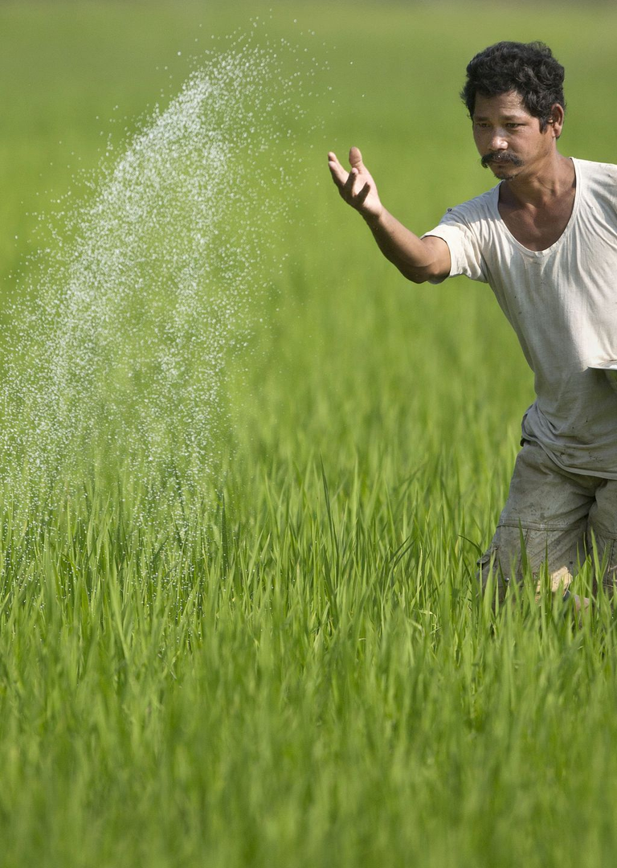
CASE STUDY 01 / INDIA
Direct Benefit Transfer — subsidies only after the sale.
India’s DBT in Fertilizers system, implemented nationwide since 2018, releases subsidies to fertilizer companies only after actual sales to farmers. Authentication happens through Aadhaar-enabled Point of Sale devices at retail shops.
Subsidies released to companies only after actual sales to farmers.
Farmers authenticate via Aadhaar-enabled PoS devices at retail shops.
Weekly subsidy claims generated based on actual sales.
Operates on a “no denial” basis — all eligible farmers receive subsidized fertilizer.
2.87 lakh
8.4 crore
50 bags/mo
RETAILERS
FARMERS SERVED
CEILING PER BUYER
Next frontier: India is now piloting land- and crop-based limits — pre-booking fertilizer based on verified need — moving from blanket to targeted subsidy.
INDIA / FERTILIZER RETAIL
Notes:
- Most directly relevant model for Bangladesh.
- Key insight: “no subsidy until the sale happens” kills the diversion incentive at the source.
- Aadhaar-enabled PoS authentication reaches 8.4 crore farmers via 2.87 lakh retailers.
- 50-bags-per-month ceiling is the demand-side cap; biometric is the verification.
- India’s next step — land- and crop-based limits — previews point 02 of our framework.

Slide 15
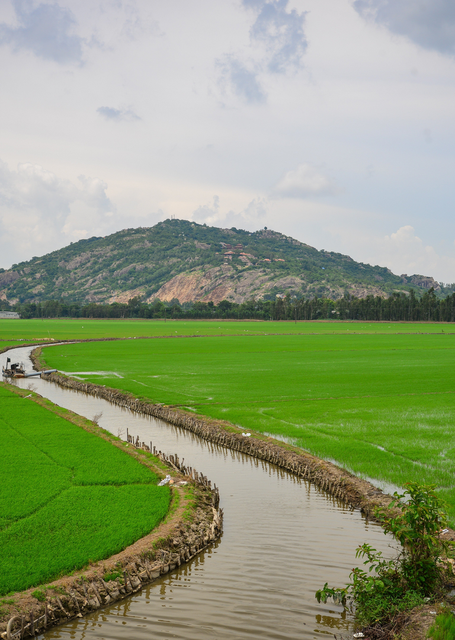
CASE STUDY 02 / VIETNAM
Less fertilizer, more yield — the precision turn.
Vietnam has taken a different but equally instructive path. The One Must, Five Reductions technique requires certified seeds while reducing seeding rates, fertilizers, pesticides, water usage, and post-harvest losses. The 1 Million Hectare High-Quality, Low-Emission Rice Program in the Mekong Delta has delivered remarkable results.
40%
50–65%
31.3%
30–70 kg
Cut in chemical N fertilizer (rice straw integration)
Reduction in seeds
Avg reduction in fertilizer use
N fertilizer saved per hectare (pilot)
Pilot models saved 30–70 kg of nitrogen fertilizer per hectare, alongside a 20% reduction in irrigation water. The takeaway for Bangladesh: reducing fertilizer use — through better practices, precise application, and organic alternatives — can improve both farmer economics and environmental sustainability.
VIETNAM / MEKONG DELTA RICE PROGRAM
Notes:
- Vietnam shows the second reform pathway — not just better-distributed fertilizer, but less fertilizer overall.
- One Must, Five Reductions: certified seeds plus five reductions (seed, fertilizer, pesticide, water, post-harvest loss).
- 1 Million Hectare Program in the Mekong Delta delivers 30–70 kg N saved per hectare.
- Complementary to the India model — Bangladesh needs both distribution reform and agronomic reform.

Slide 16
05
CHAPTER FIVE
Roadmap to Accountability
Eight requirements for a fertilizer system that is transparent, accountable, and fair.
FERTILIZER MANAGEMENT IN BANGLADESH / 16
Notes:
- Transition cue: drawing on existing resources and regional lessons.
- Introduce the eight-point accountability framework.
- Points 1–4 plug the leaks; points 5–8 redesign the system.
- North star: World Bank’s call to rebalance agriculture spending toward high-return investments.

Slide 17
THE REFORM FRAMEWORK
Eight requirements for future accountability.
01
02
03
04
Biometric Authentication at Point of Sale
Land-Linked Farmer Identification
Real-Time Tracking & Transparency
Dealer Accountability & Penalties
Swift penalties for dealers who fail to lift stock, divert to black market, or sell above official prices.
NID + Krishak Card as authentication key, mirroring India’s Aadhaar-enabled PoS model.
Quotas tied to verified land area and crop type using BDS/EDLMS geospatial data — stops wealthy capture.
Every transaction — import to farmer purchase — recorded centrally. Blockchain option for immutable audit trail.
05
06
07
08
Crop Declaration + Satellite Verification
Phased Transition from Blanket Subsidies
Local Server Architecture
Independent Oversight Body
Hybrid edge-cloud with union/upazila-level offline servers, syncing when connectivity returns — no farmer excluded.
Dedicated oversight with farmer, civil society, and expert representation — publishing regular public reports.
Pre-season crop declaration via mobile app or Union Digital Centers, cross-verified with NDVI satellite imagery.
Expand soil testing, strengthen advisory services, roll out e-vouchers to reach poor and climate-vulnerable farmers.
Notes:
- Walk through quickly — points 1–4 are about plugging the leaks in the existing system.
- Points 5–8 are about redesigning the system for the medium term.
- North star: World Bank’s call to “rebalance agriculture spending toward high-return investments.”
- Each card is individually actionable; together they form a coherent reform programme.

Slide 18
CONCLUSION
A window of opportunity — if there is the will to use it.
“
Bangladesh has the resources and the examples. The question is whether it has the resolve to build a fertilizer management system that is transparent, accountable, and fair — one that ensures every farmer gets their rightful allocation, at the right price, at the right time.
THE STAKES
THE PIECES
THE ASK
Food security, farmer livelihoods, and fiscal stability are all on the line. With 70%+ of demand met by imports, any procurement disruption turns localised shortages into a broader supply crisis.
Digital land mapping, the Krishak Card, a new 2026 dealer policy, and proven models from India and Vietnam. The reform toolkit is already assembled.
Political will, institutional capacity, and a clear roadmap. Independent oversight, biometric authentication, and land-linked quotas — phased, transparent, accountable.
The alternative is continued crisis.
Notes:
- Close by repeating the question — does Bangladesh have the resolve?
- Frame the three columns as Stakes / Pieces / Ask — the situation, the tools, the decision.
- 70%+ import dependency is the structural risk that makes reform urgent.
- Pause on “continued crisis” as the warning. Then open Q&A.

